Slide 1
The Internet Model
The Internet Model
The OSI (Open System Interconnection) model was very successful at getting people to concentrate on the specifics of a network implementation. However, implementations based directly on it were not popular, principally because they were complex and quite slow. By sticking too rigidly to the layers and following the principle of insulation between the layers it is difficult to get any real speed from an implementation.
Another model, the TCP/IP (Transmission Control Protocol/Internet Protocol) Reference Model, also called the Internet Reference Model and the Department of Defense Four-Layer Model, was developed by DARPA (Defense advance research project agency) in the 1970 with the principles of the Internet in mind: namely, resilience to damage and flexibility of application.
This is a four layer model, in contrast to the OSI model's seven (Figure below).

Slide 2
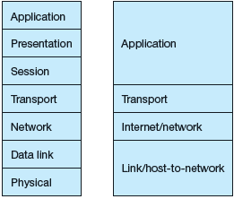
OSI
TCP/IP

Slide 3
Reference Model
Reference Model offers a means of standardization which is acceptable worldwide. Since people using the computer network are located over a wide physical range and their network devices might have heterogeneous architecture. In order to provide communication among heterogeneous devices, we need a standardized model i.e. a reference model, which would provide us way how these devices can communicate regardless their architecture.
We have two reference models such as OSI model and TCP/IP reference model, however, the OSI model is a hypothetical one but the TCP/IP is absolutely practical model.
OSI Model
OSI is acronym of Open System Interconnection. This model is developed by the International organization of Standardization (ISO) and therefore also referred as ISO-OSI Model.
The OSI model consists of seven layers as shown in the following diagram. Each layer has a specific function, however each layer provide services to the layer above.

Slide 4
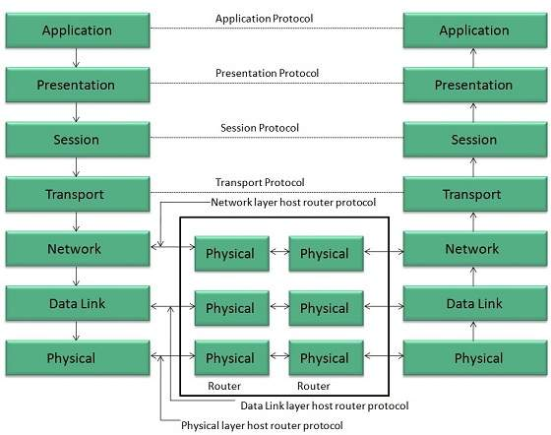

Slide 5
Physical Layer
The Physical layer is responsible for the following activities:
Activating, maintaining and deactivating the physical connection.
Defining voltages and data rates needed for transmission.
Converting digital bits into electrical signal.
Deciding whether the connection is simplex, half duplex or full duplex.
Data Link Layer
The data link layer performs the following functions:
Performs synchronization and error control for the information which is to be transmitted over the physical link.
Enables error detection, and adds error detection bits to the data which are to be transmitted.

Slide 6
Network Layer
Following are the functions of Network Layer:
To route the signals through various channels to the other end.
To act as the network controller by deciding which route data should take.
To divide the outgoing messages into packets and to assemble incoming packets into messages for higher levels.
Transport Layer
The Transport layer performs the following functions:
It decides if the data transmission should take place on parallel paths or single path.
It performs multiplexing, splitting on the data.
It breaks the data groups into smaller units so that they are handled more efficiently by the network layer.

Slide 7
Session Layer
The Session layer performs the following functions:
Manages the messages and synchronizes conversations between two different applications.
It controls logging on and off, user identification, billing and session management.
Presentation Layer
The Presentation layer performs the following functions:
This layer makes it sure that the information is delivered in such a form that the receiving system will understand and use it.
Application Layer
The Application layer performs the following functions:
It provides different services such as manipulation of information in several ways, retransferring the files of information, distributing the results etc.
The functions such as LOGIN or password checking are also performed by the application layer.

